Slide 1
Tips on generating revenue and improving care using telehealth for COVID-19
Presented by:
Dr. Yeeny Gonzalez CEO, PCP1st
Bill Bassett, President, Wanda Health

Slide 2
Dr. Yeeny Gonzalez, CEO
Located in southern FL
Specializes in customized care for high risk and those that require complex care management
Experts in the use of telehealth and remote patient monitoring, to deliver proactive care that is shown to reduce costs and improve satisfaction
Provide innovative remote healthcare solutions for CINs, ACOs, MSOs and provider offices
Develop customized programs to achieve value-based goals

Slide 3
Bill Bassett, President
Integrated telehealth solution combining predictive analytics, advanced behavioral sciences, patient engagement, and a multimodal communication platform
Active artificial intelligence brings real-time adverse event warnings into the clinical decision process
Customers are experiencing reductions in unplanned rehospitalizations and emergency department visits, increased patient satisfaction, added revenue, and improved productivity

Slide 4
Presentation Agenda
Challenges facing providers from COVID-19
PCP1st adopts COVID-19 Telehealth solution
Tips for telehealth success during COVID-19
The results of the COVID-19 program
Learnings from the COVID-19 program
Telehealth pathways: COVID-19 and beyond
Financial Model
Questions and Answers
Summary

Slide 5
Challenges facing providers from COVID-19

Slide 6
Provider challenges during the pandemic
The onset of the COVID-19 crisis has presented several new challenges for healthcare including:
Patients, especially those at high risk with pre-existing conditions, are reluctant to visit doctors’ offices, clinics, or hospitals fearing increased risks of infection of COVID-19.
Risk to clinical staff and healthcare workers and growing need to facilitate remote working, when self-isolating, to maintain high standards of care
Rapidly declining revenue at healthcare providers including doctors’ offices, clinics, and hospitals
Educating patients on the proper identification of symptoms and supporting their information needs while they are self-isolating

Slide 7
PCP1st Adopts Telehealth Solution for COVID-19

Slide 8
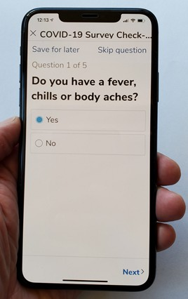
The PCP1st Solution – Wanda Health
Deployed the COVID-19 Telehealth solution
Providing patients and quarantined individuals with automated symptom screening
Supported remote ongoing care management for symptomatic and positive patients
Improved safety for patients and care team
Easy to use workflow and mobile care support
Multi-function telehealth services optimized internal workflow
Multi-modal communications with patients supports patient-centered delivery (landline, IVR, mobile, Text, mobile app)

Slide 9
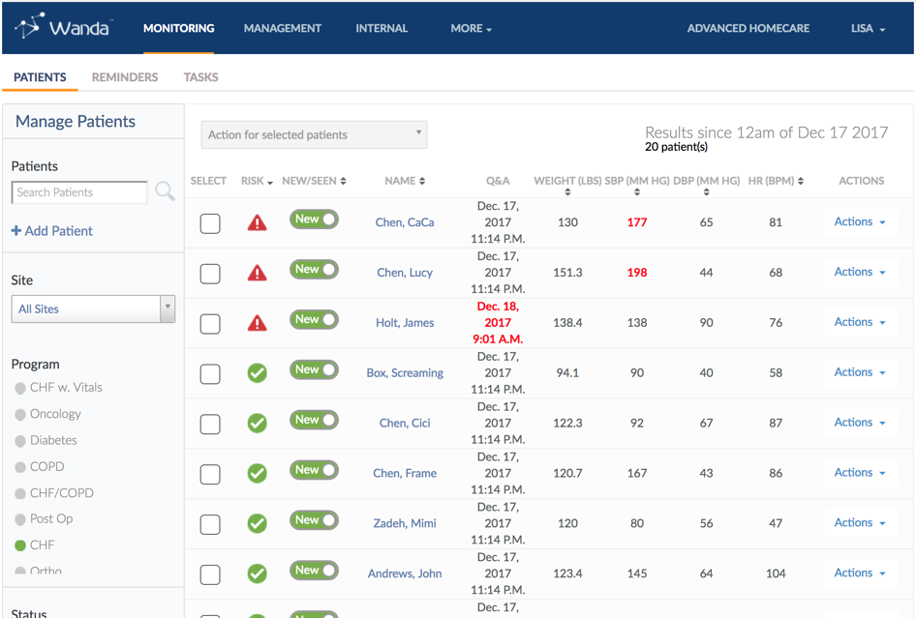
The COVID-19 Screening Program
Program followed a “rapid deployment” process going live within 12 days
Data collection followed symptom guidance from the CDC
Program designed to support reimbursement requirements
Patients sent automated COVID-19 Daily Health Checks™

Slide 10
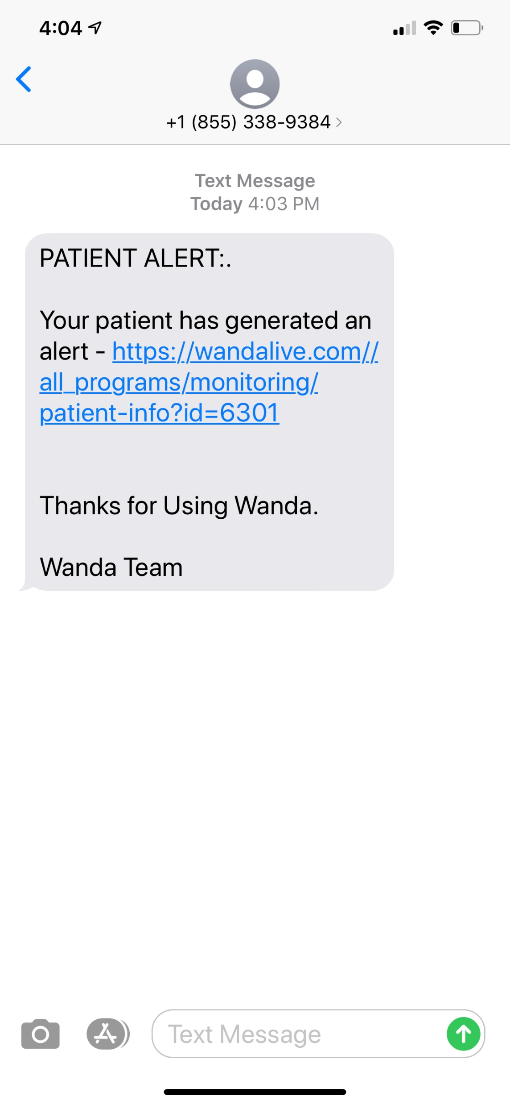
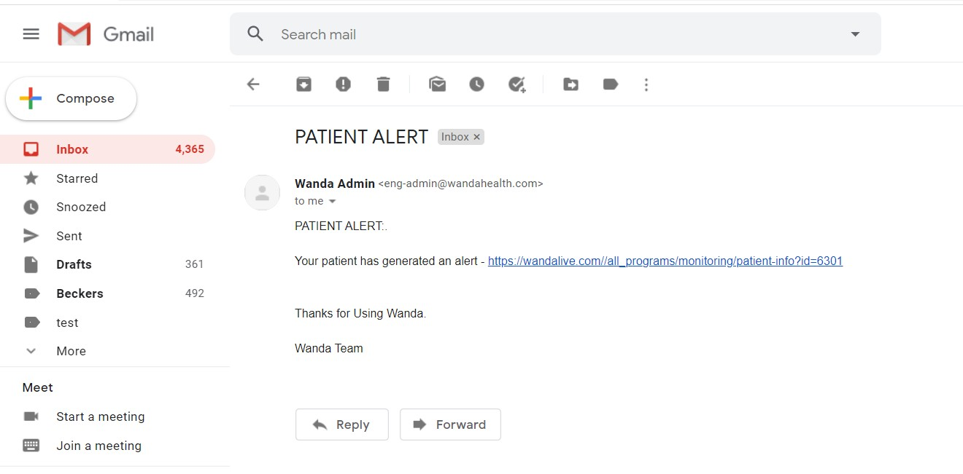
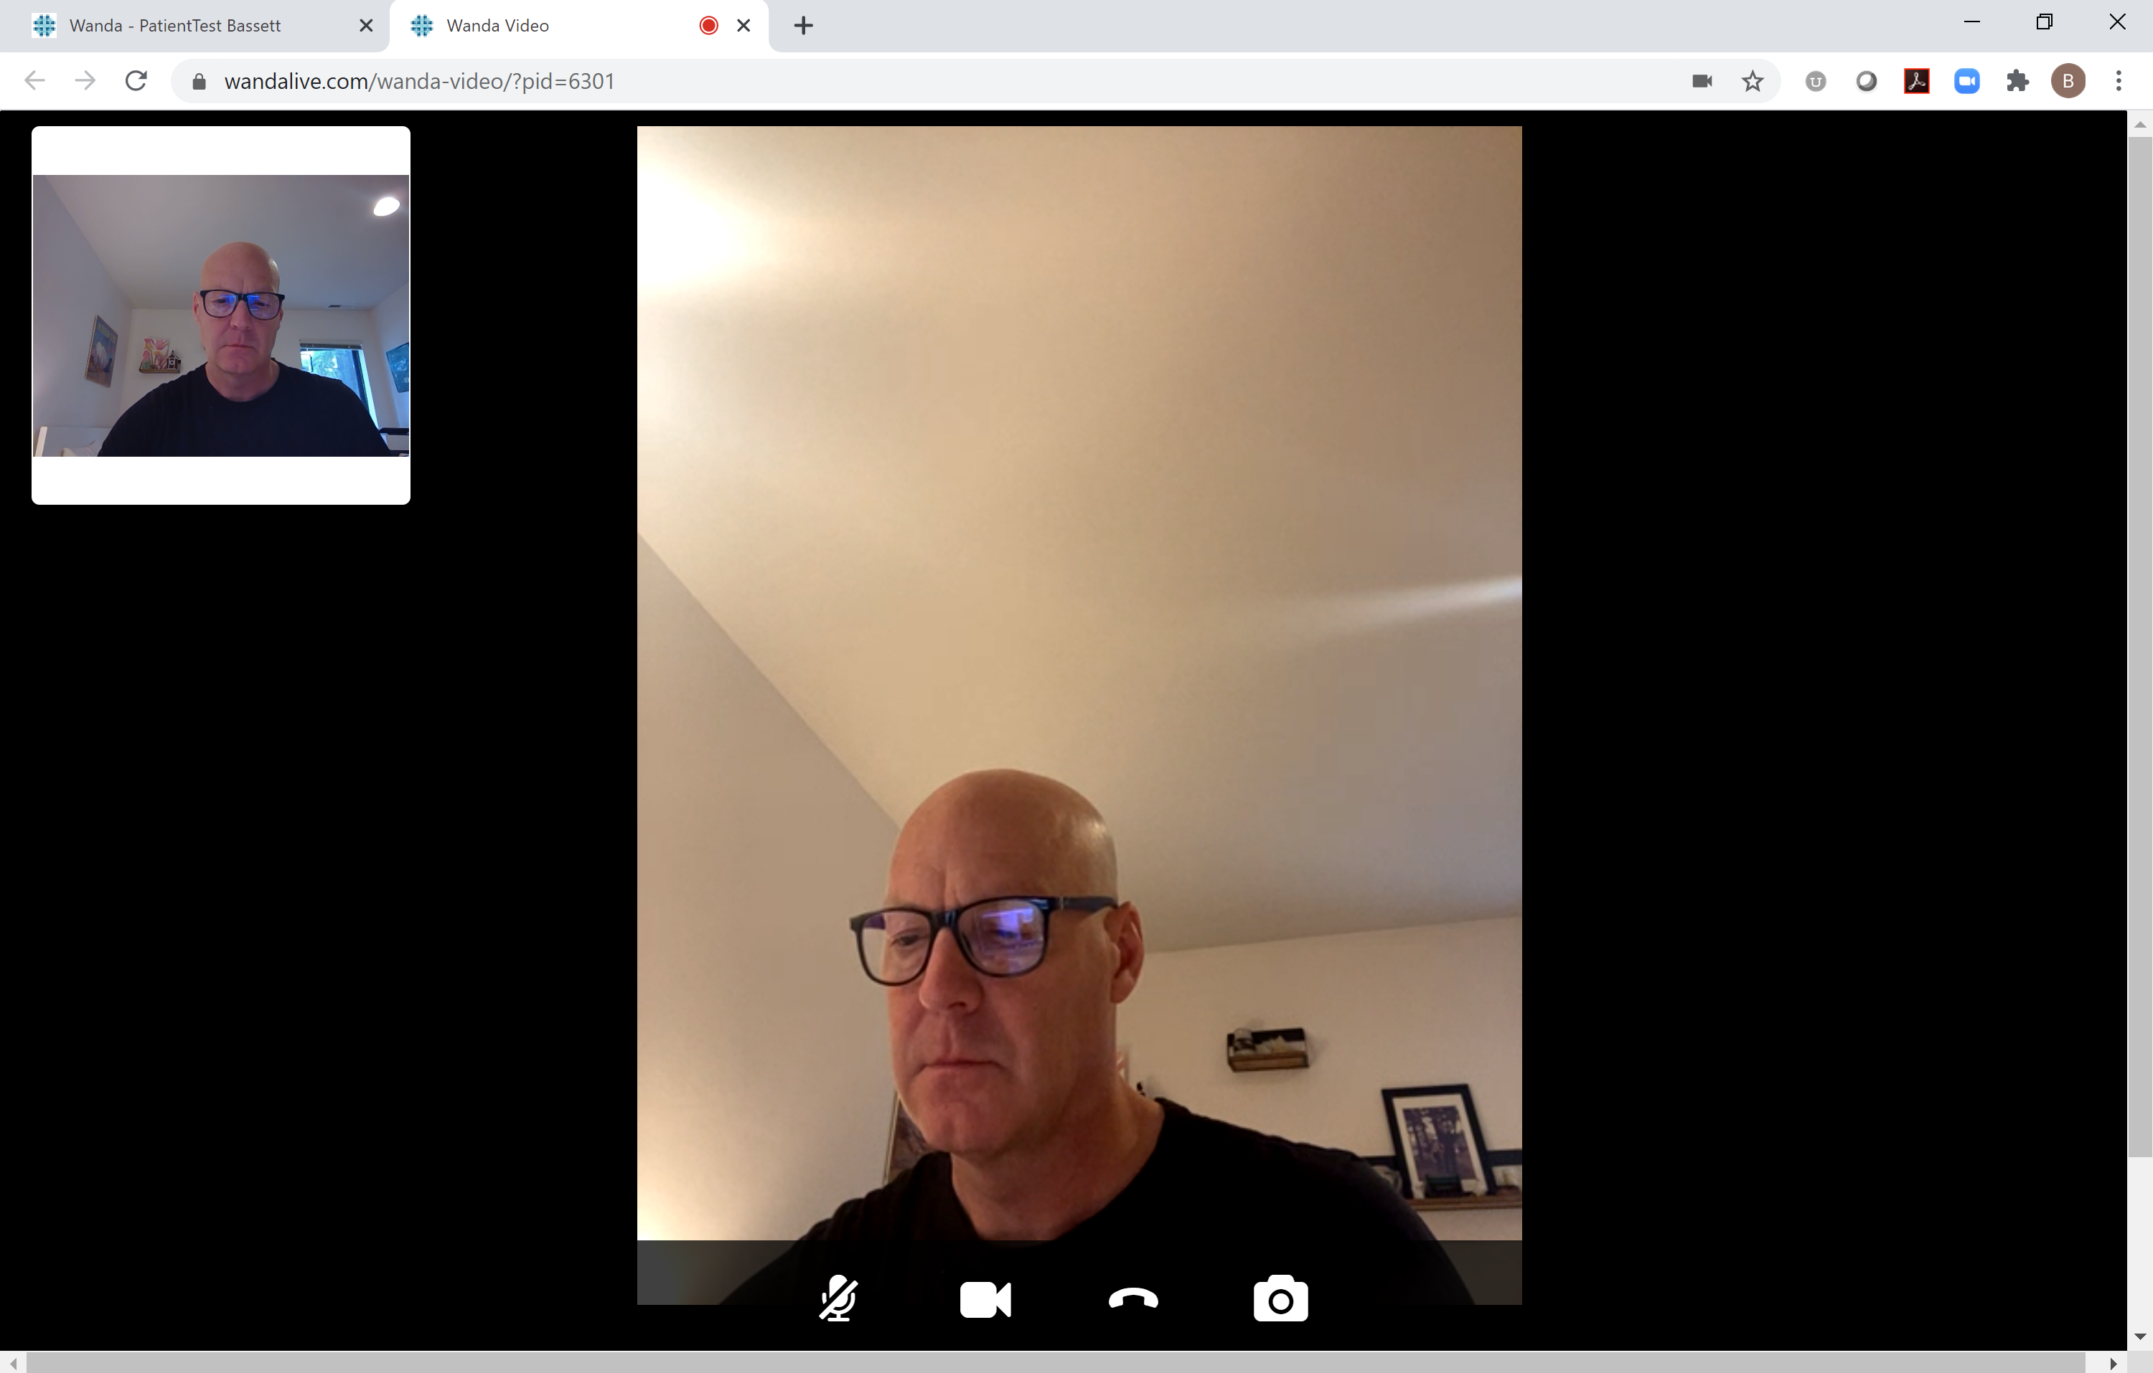
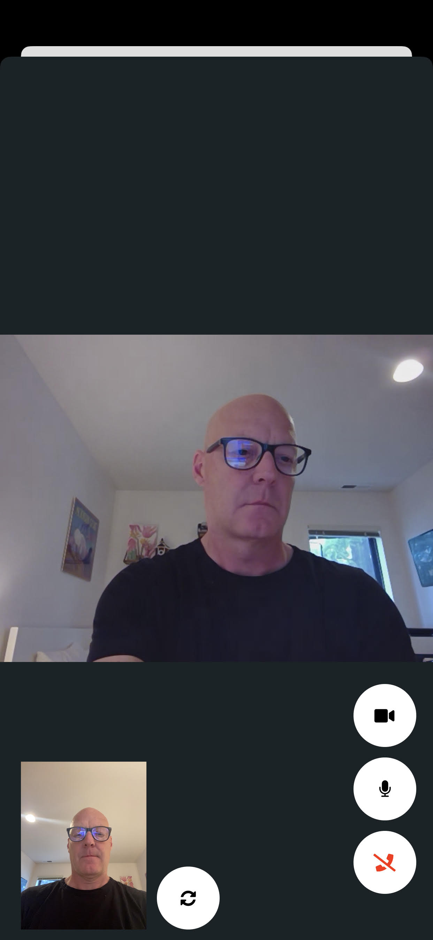
Interactive Telehealth
Doctors and care team were notified of symptomatic patients in real time with COVID-19 Telehealth Alerts
Doctors, staff and patients interacted using Wanda Health’s embedded video and voice conferencing
Enact interventions
Respond to questions about COVID-19 and care
Provide remote support for care, medication management, etc.

Slide 11
Tips for a Successful Telehealth Program During COVID-19

Slide 12
Building a successful program
Have a well-defined internal workflow process
Make sure entire team understands the workflow and their roles
Handoffs
Escalation
Follow up on interventions
Coverage for “out of office” staff
Use the proper telehealth functions during care – integrate their use
Telehealth Service | Use Cases
Symptom screening/Data collection | Use for automated COVID-19 Screening
Multi-party Video/Voice conferencing | Use for validation, care management and support, E/M visits, training, clinical consultations, case conferencing
Automated reminders, call back requests | Patient engagement and adherence
Remote monitoring | Ongoing care of high-risk patients, patients with COVID-19 who can stay at home, blood-pressure/vital sign management
Notes:
Not all telehealth is the same. Understand the differences and how they support the care you are trying to provide. For example, online conferencing will only allow you to provide a replacement for in-person visits. Not additive value or revenue

Slide 13
Insights for Implementation Success
Training, Roll Playing, and Practice before rollout
Staff need to actively embrace the telehealth technology in how they deliver care
Daily stand ups to review issues or questions on telehealth workflow
Track daily use metrics to support program visibility and transparency
Choose systems that are easy to use
Provide reliable data on patients to support intervention
Use system that supports your workflow
Speed of data and mobility are key
Audit and billing support
Initial stress test in team to evaluate workload changes
Pent up patient demand was significantly underestimated
Have adequate staff at the office
Don’t send out automated Daily Health Checks to all patients at one time

Slide 14
Analyzing the Results of the COVID-19 Telehealth Program

Slide 15
Program Operational Metrics
The following were achieved in the first 30 days of the program
6,951 automated COVID-19 calls delivered
95% via Interactive Voice Response
Selected since phone # was common data across all patients
2,460 completed COVID-19 Daily Health Checks
Notes:
Saw a shift as staff and patients became accustomed to using telehealth. Productivity increased and staff used telehealth as part of their normal care program.

Slide 16
Results: Outbound telehealth encounters completed by care team
Notes:
Huge demand for initial COVID-19 information in April

Slide 17
Results: Total hours per month on outbound telehealth
8% increase
Notes:
Staff adjusted to telehealth as part of care program

Slide 18
Results: Unique patients with telehealth encounter
17% increase
Notes:
Ease of use and workflow adjustment increase productivity and efficiently of using telehealth reaching more patients in their panel.

Slide 19
Results: Billable telehealth encounters
32% increase in billable encounters
Notes:
Increase in productivity and patient familiarity with telehealth improved billable encounters

Slide 20
Results: Percent with COVID-19 symptoms
1191 patient responses indicating 1 or more symptoms

Slide 21
Results: Overall program patient satisfaction
82% Patients Satisfied with the COVID-19 Program
N=1191 patient responses

Slide 22
Results: Patients needing medication help
N=812 patient responses

Slide 23
Results: Patients needing help from care team
Total 803 responded to callback requests

Slide 24
Learnings from the COVID-19 Telehealth Program

Slide 25
Key Learnings
Strengthened patient-provider relationships
Reached entire patient panel
Enough engagement to bring patients back into the practice
Identification and care of at-risk patients
Strong levels of patient satisfaction with the program
Additional billable telehealth encounters generated
Expedited patient information needs
Supported safety for patients and care team
Patients were relieved not to have to come to the office
Clinical teams could conduct patient care while self-isolating or at home

Slide 26
Key Learnings (continued)
Ease of use for clinical teams improved productivity
32% increase in billable telehealth encounters
17% increase in unique patients with a telehealth encounter
Patient notification of the COVID-19 notification will increase adherence
Some were unsure if it was real or not, hung up
Have a defined workflow that incorporates all telehealth functions and responsibilities
Use appropriate tools to optimize care management
Make sure team members have understand the tasks to be completed on each telehealth encounter
Not just a “phone call”
Maximizes clinical documentation
Achieved billing requirements

Slide 27
Telehealth Migration Paths for Providers… COVID-19 and Beyond

Slide 28
Migration Forward with Telehealth
Using telehealth to support COVID-19 patient care through the PHE
Programs for in-home screening watching for symptoms. If symptoms present, provide COVID-19 testing
Programs for COVID-19 Management via remote patient monitoring
Telehealth encounters to in addition to in-office or “curb-side” visits
135 Medicare Telehealth Services that are designated Temporary Addition for the PHE for the COVID-19 Pandemic
Medicare PFS Telehealth Services for PHE for the COVID-19 pandemic

Slide 29
Migration Forward with Telehealth
2020 Programs with Billing Codes
Remote Physiologic Monitoring (RPM)
Codes: 99453, 99454, 99457, 99458
Covers set-up of devices and patient education on using equipment, the devices used for monitoring, and both standard and extended time for actual remote patient monitoring and treatment management services. Chronic and acute conditions. Physician/Qualified Health Professional (QHP)
Self-Monitored Blood-Pressure (SMBP)
Codes: 99473, 99474
Covers the calibration of a BP device and patient education on how to measure blood pressure at home and time spent on reviewing results and treatment management services.
Virtual Check-ins
Code: G2012 (QHP) 99896,98967,98968 (Non QHP)
Enables provider offices to bill for time-based technology-enabled remote visit between physician or QHP with patients

Slide 30
Migration Forward with Telehealth
2020 Programs with Billing Codes
E/M Telehealth Visits
Codes: 99441, 99442, 99443 (Phys/QHP)
Covers telehealth visits for new or established patients for patients that are evaluated for an E/M Telehealth, Telephone visit
Chronic Care Management (CCM)
Codes: 99490, 99478, 99489, GCCC1, G2580
For non face-to-face time working with patients in managing their care and treatment services. CCM 2+ chronic conditions

Slide 31
Telehealth Pathway Example
Assumptions: New patient, low level of Chronic Care Management, Non-Facility based
Program | Code | Rate/Month | 100 patients/year
Initiation | G0438 – Initial visit to be initiated into the program (1X) | $164 | $16,400
Chronic Care Management (CCM) | 99490 – 20 mins/month of general supervision of non-face to face care | $42 | $50,400
 | G2058 – 20 additional minutes per month of general supervision
Remote Patient Monitoring (RPM) | 99453 – RPM set up and patient education (1X) | $19 | $1,900
 | 99454 – Device supply and daily recording per month (min 2 days needed during PHE) | $64 | $76,800
 | 99457 – 20 min/month of general supervision of RPM services requiring interactive communication | $52 | $62,400
 | 99458 – Additional 20 min/month of RPM services. | $42 | $50,400
$258,300

Slide 32
In Summary…
The use of telehealth to support care during the PHE improved productivity and supported revenue generation
Its use can help strengthen the provider-patient relationship
Patients are highly satisfied and engaged using telehealth
Numerous telehealth programs from which to choose
Choose the appropriate telehealth technology to support needs

Slide 33
Questions and Answers…
We are happy to respond to your questions

Slide 34
Tips on generating revenue and improving care using telehealth for COVID-19
Presented by:
Dr. Yeeny Gonzalez CEO
PCP1st
ygonzalez@pcp1st.com
561-372-1643
Bill Bassett, President
Wanda Health
bill@wandahealth.com
206-472-5584

